Slide 1
WELCOME TO MY Portfolio

Slide 2
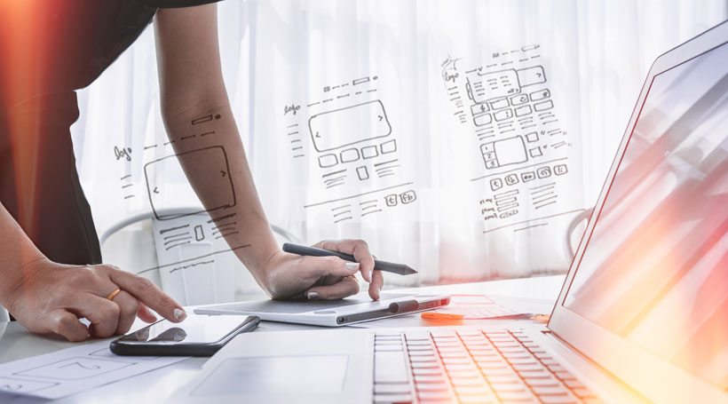
Web Development Project Presentation
Assalamu Alaikum Everyone
Today I will show our Web-Development Project.Hope Everyone will see…

Slide 3
Web Development Project Presentation
Personal website Portfolio
The goal of this project was to design a web portfolio for a graduating design student and to report on the process. The project is based on the existing personal visual identity of the student. This paper is created as an instruction for the reader describing the process of personal online portfolio design simply by defining and explaining the main terms and methods used for web design and development. This thesis work consists of six parts, depending on how the design process proceeded. These parts include research, project management, content development, information gathering, design and an overview of the development process and techniques. The objective of this work is to create guidelines for newcomers in the design industry.

Slide 4
Web Development Project Presentation
Languages Used In Project
This project is made up of HTML, CSS, JavaScript, Bootstrap, PHP and MySQL. The website is designed with HTML, CSS, Bootstrap and JavaScript. The backend of the website is built with PHP and MySql.

Slide 5
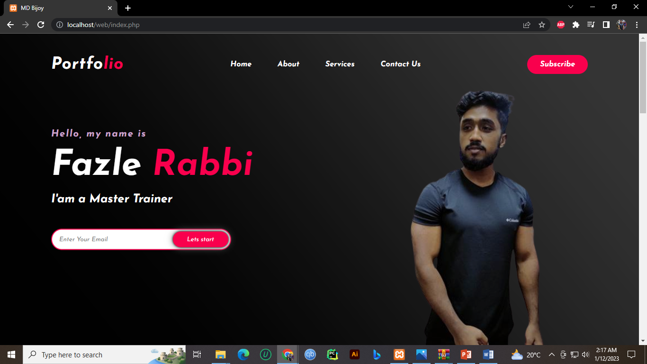
Web Development Project Presentation
Website Interface

Slide 6
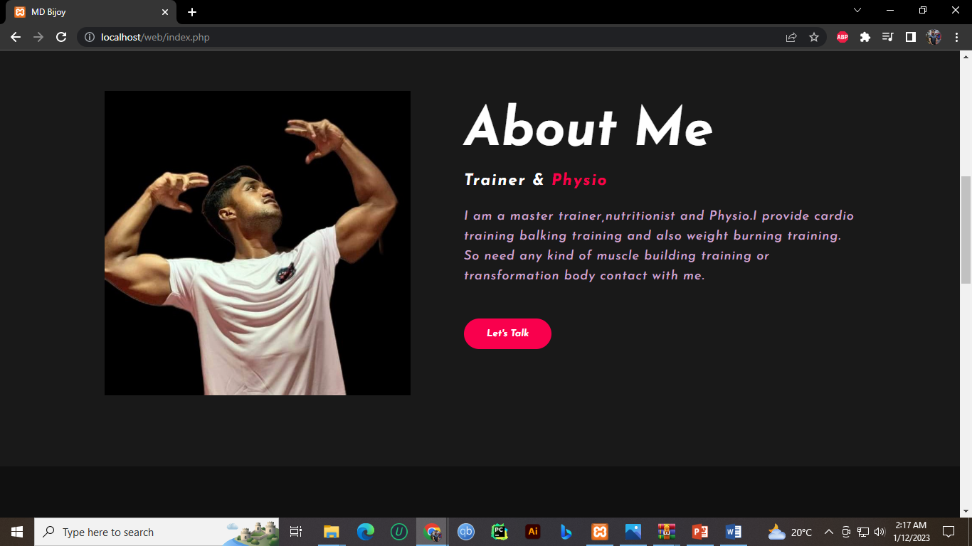
Web Development Project Presentation
About profile

Slide 7
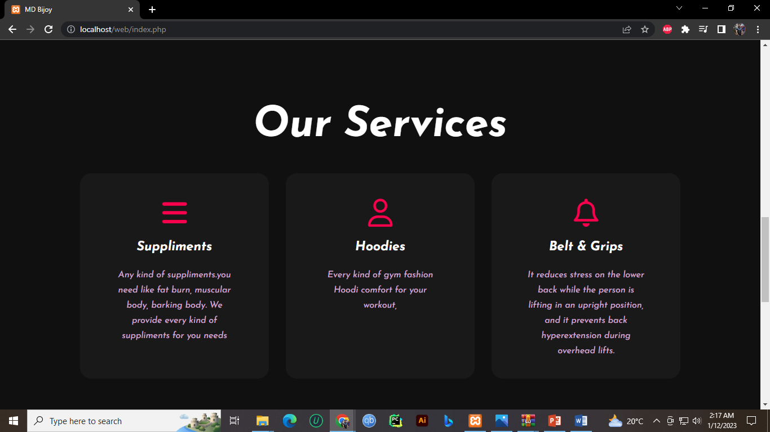
Web Development Project Presentation
Services Section

Slide 8
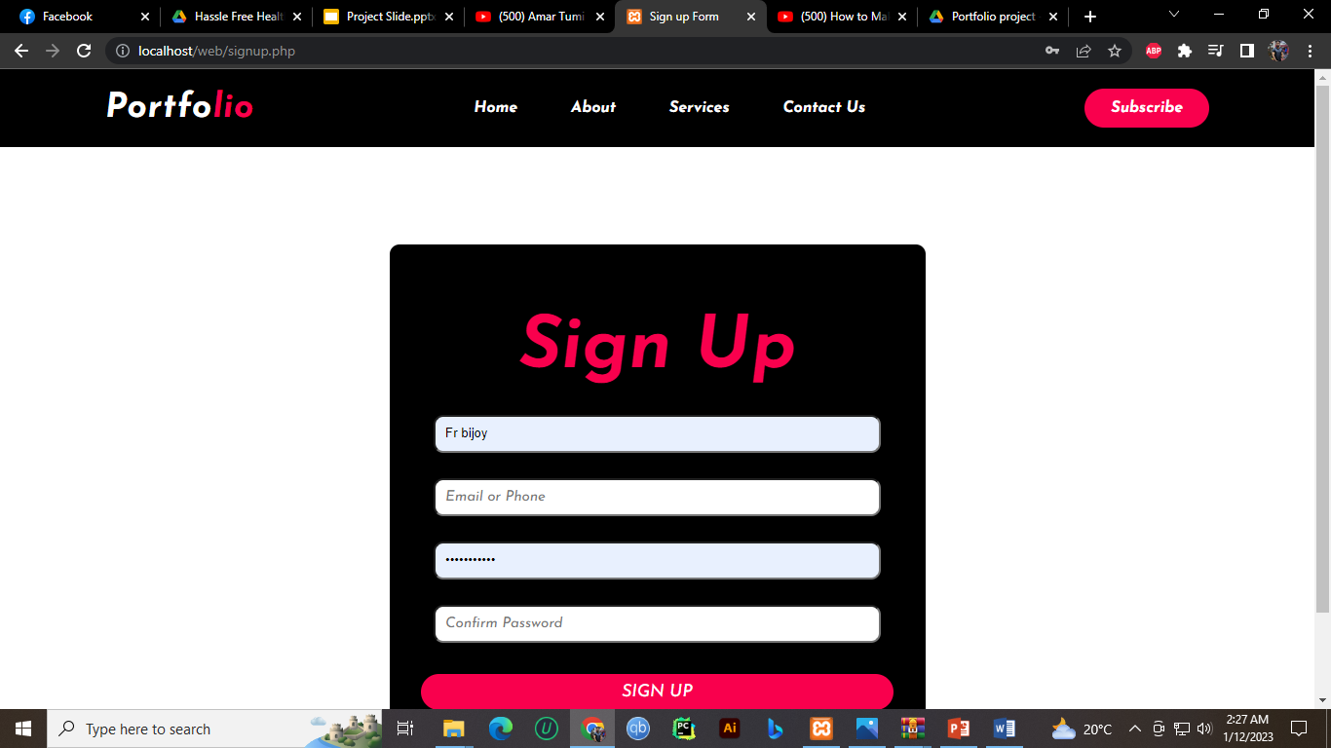
Web Development Project Presentation
Sing up

Slide 9
Web Development Project Presentation
Thank You Everyone To Give Me Chance For Presentation…
Assalamu Alaikum.

